Slide 1
Diagnostic analysis of crimes in Sri Lanka
CS5617 - Data Science
Final Project
By Team 10

Slide 2
Introduction
The heavily increasing crime rate is a major problem for a developing country like Sri Lanka
It is important to prevent crimes, rather than taking legal actions afterward
At present, Sri Lanka has a lesser amount of policies and practices to reduce crimes
Our motivation is to analyze gov.lk data to identify what factors affect the growth in crimes
Sri Lankan government will be able to take necessary actions to reduce crimes, through this analysis

Slide 3
Dataset
We integrated 4 datasets joined by district.
We performed a correlation analysis for above datasets to identify highly correlated factors.
Crime Data of 2012 | http://www.data.gov.lk/dataset/crime-data-2010-2012
Employees by industrial sector (% to total employment) | http://www.data.gov.lk/dataset/employees-industrial-sector-2012
Information for Accommodation | http://www.data.gov.lk/dataset/accommodation-information-tourists
Population by district in census years | http://www.data.gov.lk/dataset/population-district-census-years
Notes:
We went through all the datasets and selected more crime related data

Slide 4
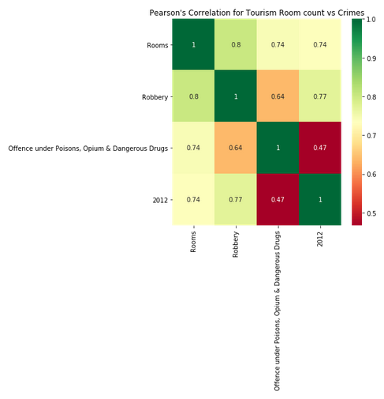
Correlation Analysis
Popularity of tourism causes a lot of crimes including,
Robbery (0.81)
Dangerous drugs (0.8)
Notes:
Normalized plot added

Slide 5
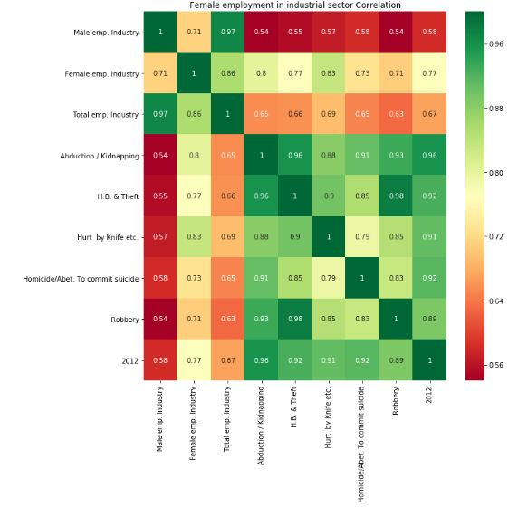
Correlation Analysis
Female employment in industrial sector relates to crimes like,
H.B. & Theft (0.77)
Hurt by knife (0.83)

Slide 6
Hypotheses
Higher female employment in industrial sectors stimulates growth in crimes
Hypothesis 1
H0: More Females working in Industry sector has no relation to high Hurt by Knife crime
H1: More Females working in Industry sector has relation to high Hurt by Knife crime
Hypothesis 2
H0: More Females working in Industry sector has no relation to high H.B. & Theft
H1: More Females working in Industry sector has relation to high H.B. & Theft
Notes:
Therefore above hypotheses were tested for statistical significance and All null hypothesis were rejected by 5% significance level

Slide 7
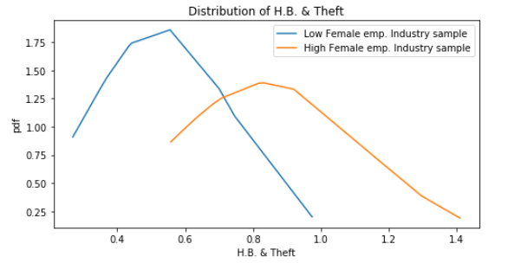
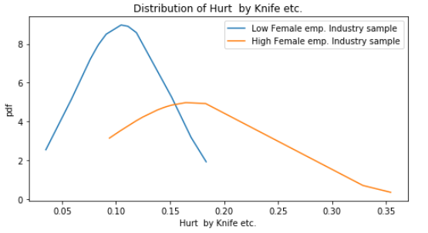
High female employment in industrial sector
Results in high crimes
Notes:
To analyze this further, we divided the dataset into 2, lowe female emp sample and high female emp sample
These are the distributions for them

Slide 8
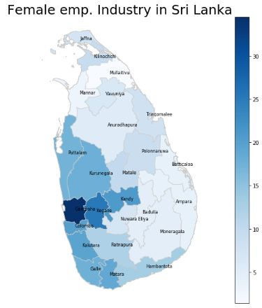
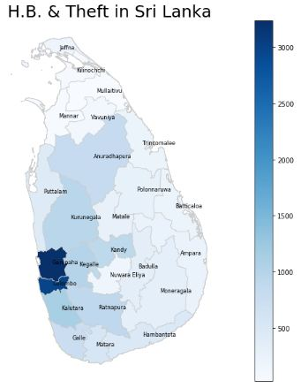

Slide 9
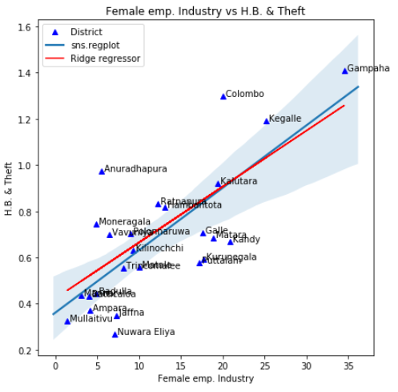
Regression for H.B. & Theft prediction
We use a linear model to predict H.B. & theft given a district which has a particular female employment in industrial sector and/or tourism.
Ridge regression was used since we have small data set (25 districts)
Even though this is not a time-based prediction, still useful to predict theft for a district given female employment in industrial sector.
Mean score of 3-fold cross validation
Using female emp. (0.4913)
Using tourism (0.0579)
Using both features (0.5264)
Notes:
H.B. Theft is normalized by population here.
What is H.B.? Assumed Home breaks
Ridge regressor is used (https://scikit-learn.org/stable/modules/generated/sklearn.linear_model.Ridge.html )
Alpha = 0.1 (Strength of regularization for Ridge)
Normalization enabled for Ridge.
3-Fold cross validation was performed.
Score = 0.4913078638686361 (Best is 1.0 and random will be 0.0)
Refer the section of score in https://scikit-learn.org/stable/modules/generated/sklearn.linear_model.LinearRegression.html

Slide 10
Hypotheses cont.
Popularity in tourism relates to higher crime rate
Hypothesis 1
H0: Number of tourist Rooms and Crimes under Robberies are Uncorrelated
H1: Number of tourist Rooms and Crimes under Robberies are Correlated
Hypothesis 2
H0: Number of tourist Rooms and Crimes under "Offence under Poisons, Opium &
Dangerous Drugs" are Uncorrelated
H1: Number of tourist Rooms and Crimes under "Offence under Poisons, Opium & Dangerous Drugs" are Correlated
Notes:
NOT Normally distributed.
Therefore, Spearman’s Rank correlation was calculated for above two hypotheses.
we were able to reject the null hypotheses(H0) claiming that there is no correlation between above parameters with 95% confidence.

Slide 11
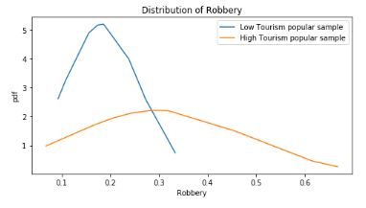
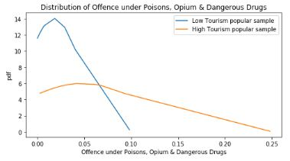
Popularity in tourism relates to higher crime rate

Slide 12
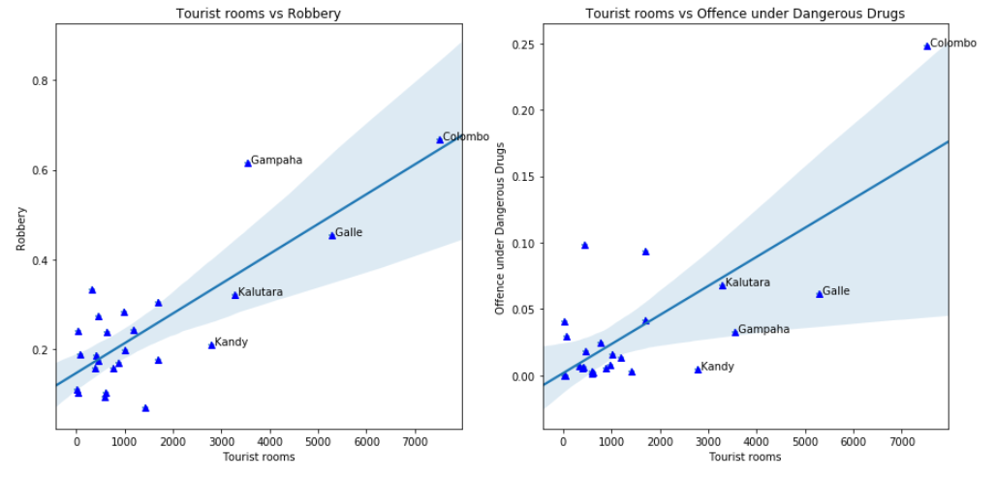
Tourism is linearly related with Robbery and drugs

Slide 13
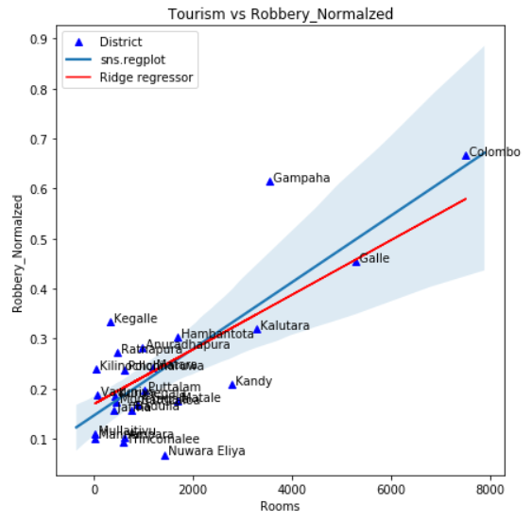
Regression for Robbery prediction
Same technique was used as previous
Predicted robberies given a district with tourism popularity
Mean score of 3-fold cross validation
Using tourism (0.4689)
Using female emp. (0.1962)
Using both features (0.6039)
Notes:
H.B. Theft is normalized by population here.
What is H.B.? Assumed Home breaks
Ridge regressor is used (https://scikit-learn.org/stable/modules/generated/sklearn.linear_model.Ridge.html )
Alpha = 0.1 (Strength of regularization for Ridge)
Normalization enabled for Ridge.
3-Fold cross validation was performed.
Score = 0.4913078638686361 (Best is 1.0 and random will be 0.0)
Refer the section of score in https://scikit-learn.org/stable/modules/generated/sklearn.linear_model.LinearRegression.html

Slide 14
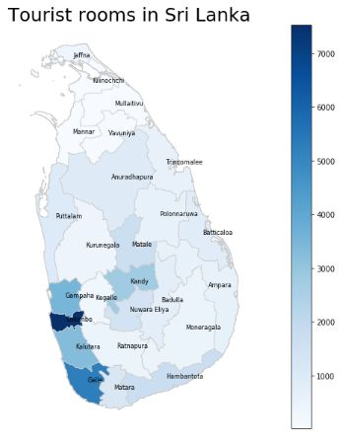
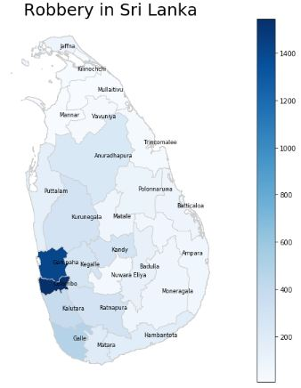

Slide 15
Techniques Used
Visualization (heatmaps/ Geomaps/ boxplot/ histogram/ bar chart/ scatterplot)
Missing value handling
Ex:- Population of Chilaw district
Rollup data/ Feature engineering (Room count each hotels to District level)
Data integration (merge datasets by District)
Normalization (crime data normalized by population)
Correlation analysis/ test
Normal distribution test
Hypothesis testing - t-test and Spearman’s rank order correlation
Single/Multivariate linear regression (Ridge)
Cross validation (K-fold)

Slide 16
Conclusion
Interestingly tourism popularity, which is derived from room count per district, has strong relationship to crimes like offences under dangerous drugs and robbery
Female employment in industrial sector somehow stimulates crimes like Home Break & theft, Hurt by knife
These claims are statistically significant
Government and industry sectors work hard to improve female employment and enhance tourism incomes, but do they have enough policies and barriers in place to prevent these crimes?
Notes:
Both tourism and female employment industry are important factors behind the economy of sri lanka
But as all of u can see, (relationship)
These criminal activities would affect the safety of tourists and the locals in that region.
As time goes on tourist attraction for those regions might get reduced

Slide 17
Thank You

